Slide 1
The basics of unsupervised learning
Soumya banerjee

Slide 2

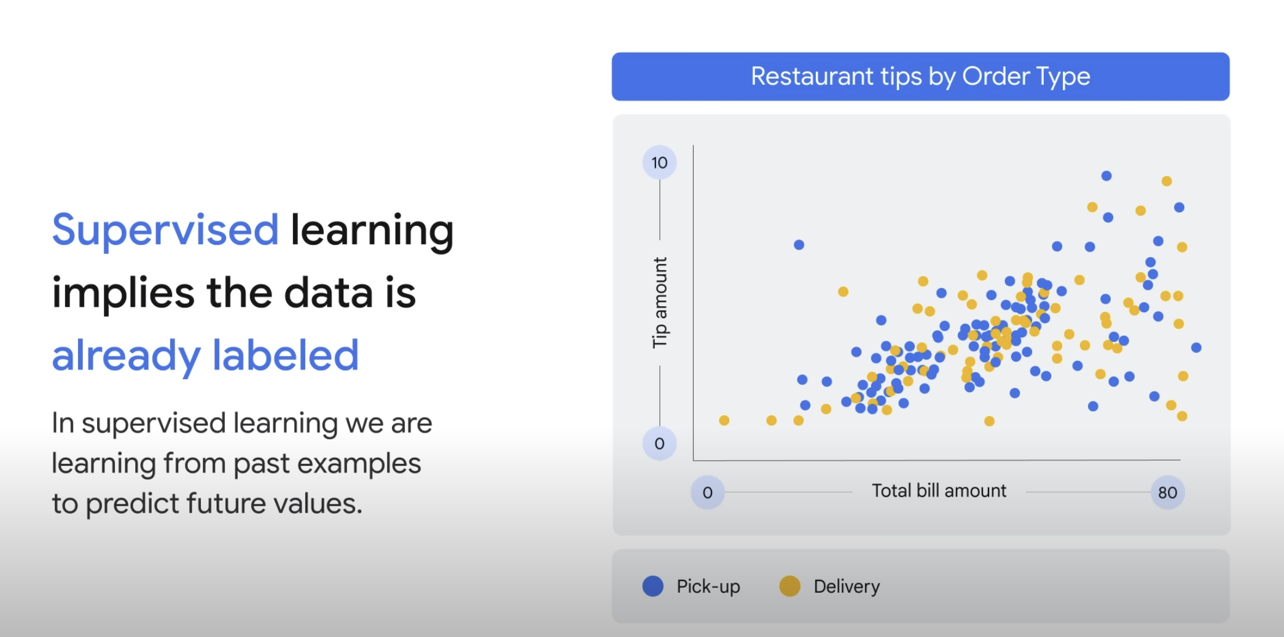
Supervised learning

Slide 3
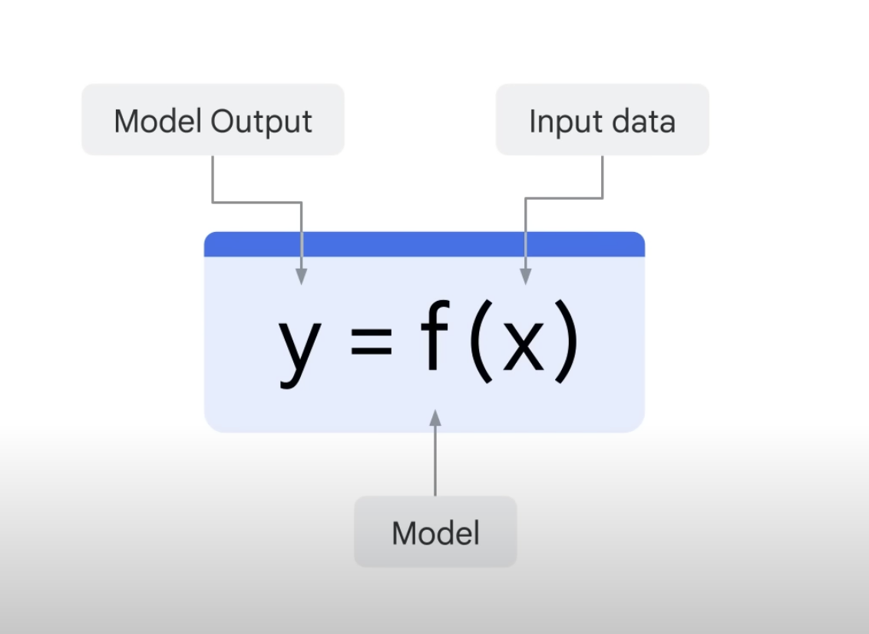
Supervised learning

Slide 4
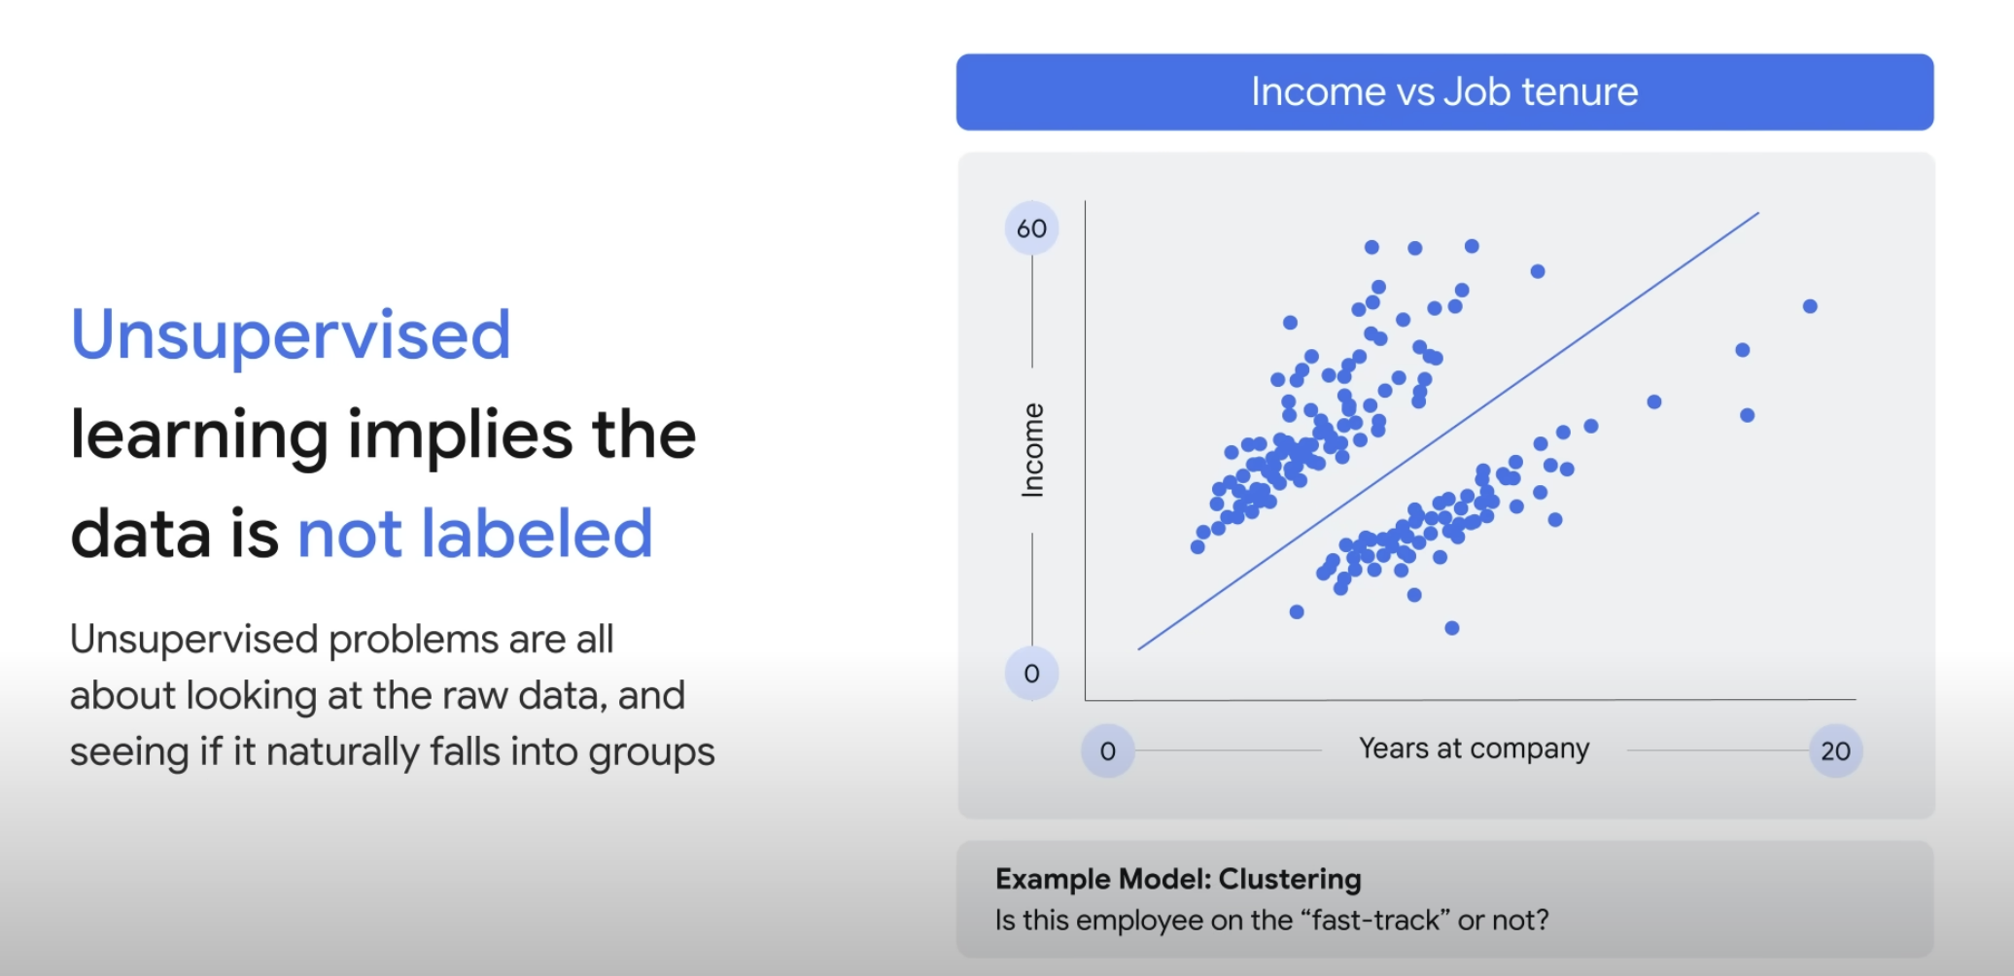
unSupervised learning

Slide 5
unSupervised learning

Slide 6
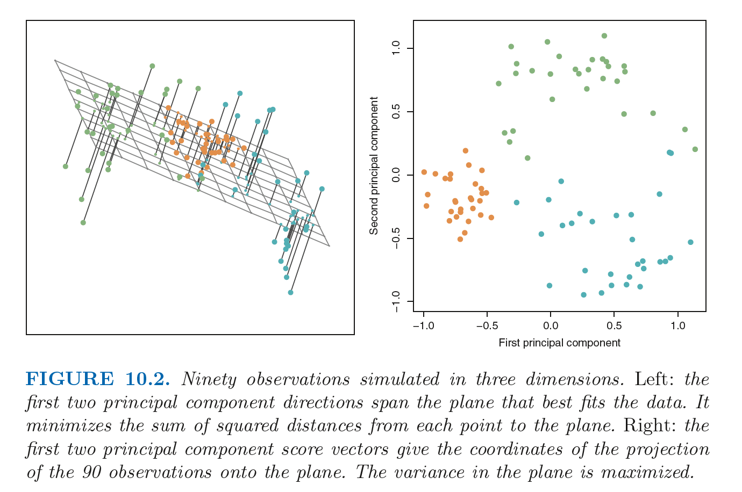
unSupervised learning

Slide 7
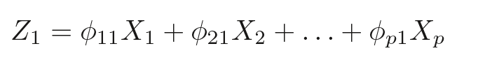
unSupervised learning

Slide 8
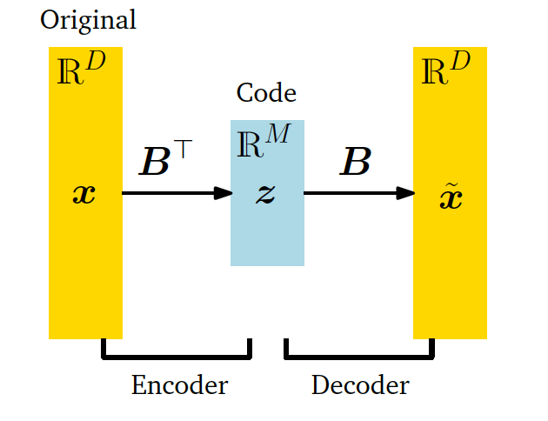
Important concept
Information bottleneck

Slide 9
applications of this idea
Finding structure in movie ratings
Patterns in consumer behaviour
Stratifying patients
Notes:
Segue into SVD, movie recommendation, low rank approximation
https://www.google.com/search?sca_esv=567212709&sxsrf=AM9HkKmE-kwKrMhveThIVW6Y-juk-QAoNg:1695290052959&q=movie+recommendations+svd&tbm=isch&source=lnms&sa=X&ved=2ahUKEwjMhpfLt7uBAxU7UUEAHQVuDY4Q0pQJegQIDRAB&biw=1292&bih=670&dpr=2.2#imgrc=U1BqzLZvwC9O3M

Slide 10
assumptions
Linearity (linear relationship between data points and lower dimensional representation)
Loss function/reconstruction error (squared loss)
Uses the dot product (one type of inner product)

Slide 11
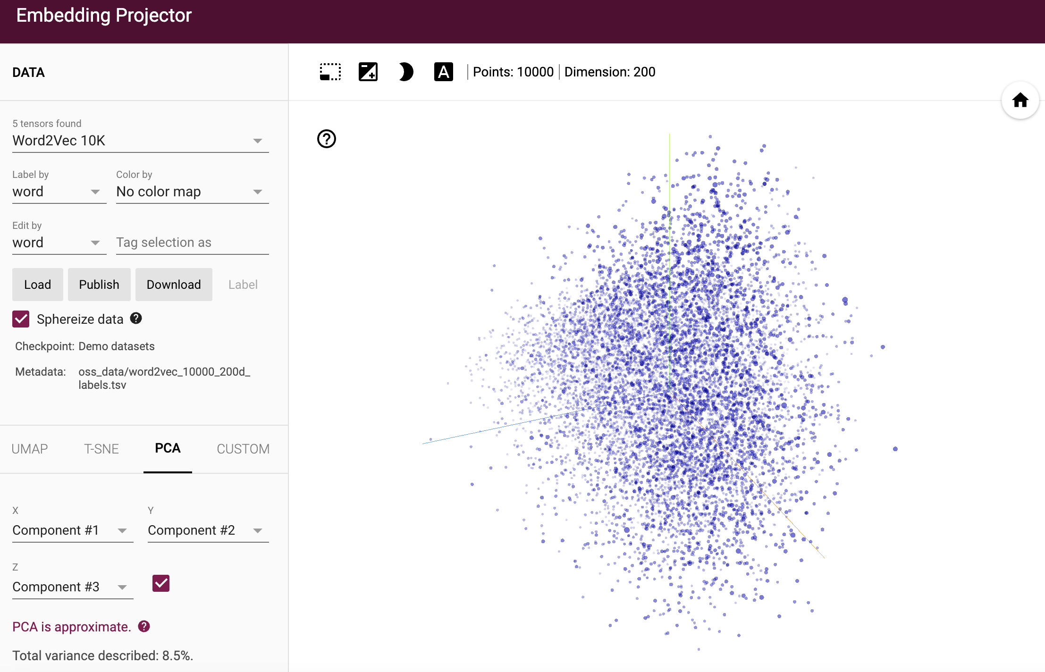
activities
http://projector.tensorflow.org/

Slide 12
generalizations of this idea
tSNE
Autoencoder (non-linear loss function)

Slide 13
pitfalls
Distances not preserved
tSNE can be used for hypothesis generation. There are many pitfalls to this.
https://distill.pub/2016/misread-tsne/
Other pitfalls: distances not preserved. For example, a 2d map is a projection from 3D

Slide 14
Case studies
removing outliers in genomic data using PCA.
Frequently in genomic data we may have to remove outliers. These outliers may be due to technical/batch effects or unknown reasons not connected to biology.
This has implications for any tests performed downstream. For example, t-tests can be performed downstream after performing PCA. If there are outliers, it may affect the results of the t-test. See \cite{Aschenbrenner2019} for an application to bulk and single-cell sequencing data.

Slide 15
Case studies
Visualization/dimensionality reduction pitfalls
Pitfalls
https://distill.pub/2016/misread-tsne/
Other pitfalls: distances not preserved. For example, a 2d map is a projection from 3D

Slide 16

Case study
Notes:
Example of IL10 project (tSNE and heatmaps from a bioinformatics project)

Slide 17

Case study
Notes:
Example of IL10 project (tSNE and heatmaps from a bioinformatics project)

Slide 18
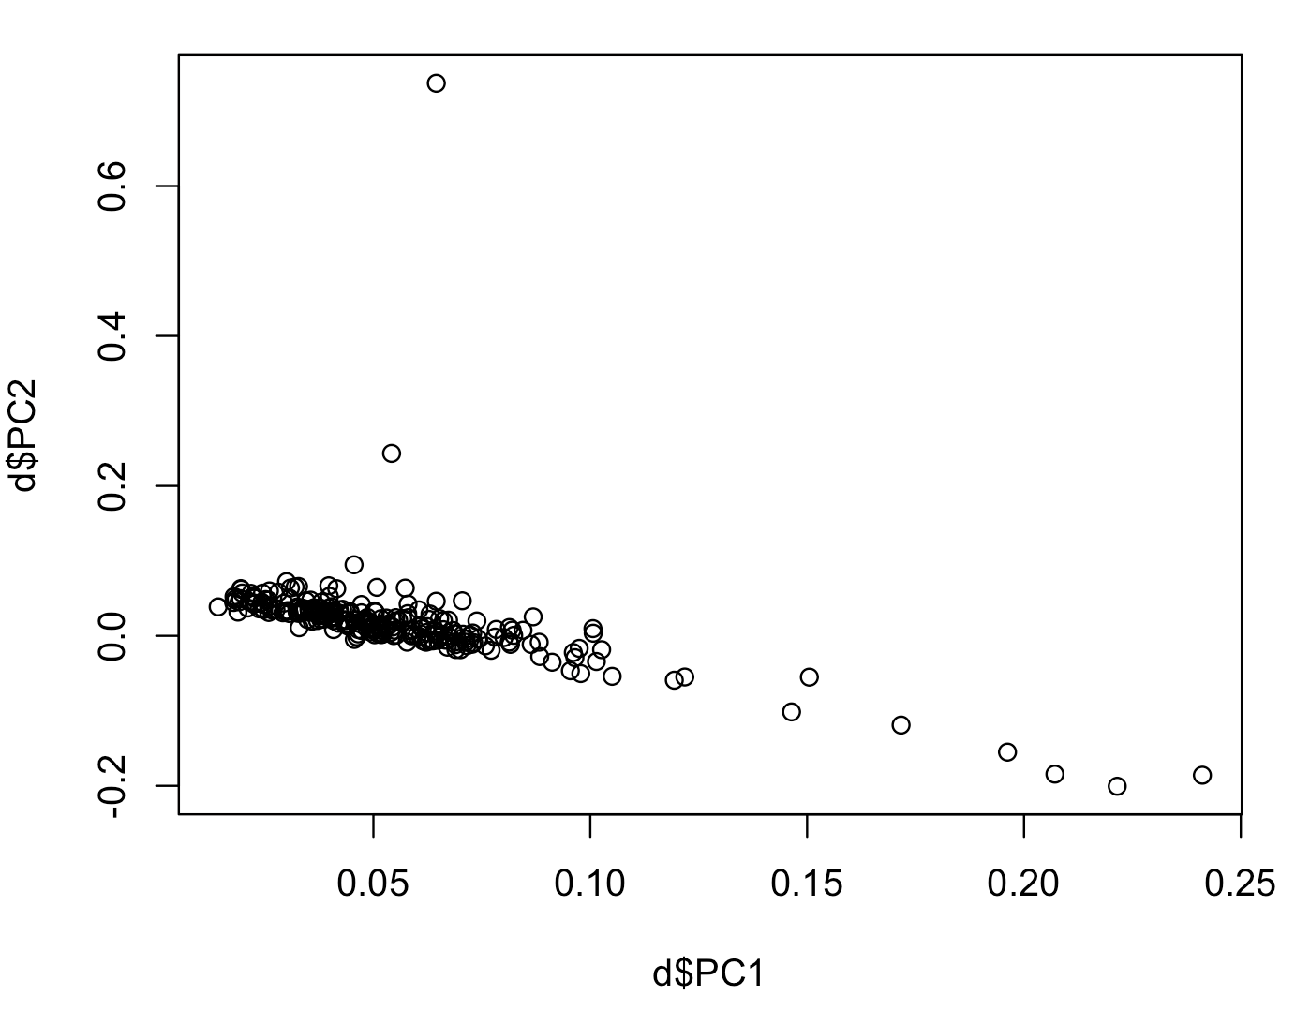
Notes:
Example of IL10 project (tSNE and heatmaps from a bioinformatics project)

Slide 19
T-test
Notes:
Example of IL10 project (tSNE and heatmaps from a bioinformatics project)

Slide 20
Design matrix Glm Correlated periodic Exponential Hiow to pick How do I get to this out of data How do I communicate this to stakeholders More tools for data visualization Generate data Visualize it High dumenosional data Results visualizE Communicate this Cancer woring link winter environmental actiivis Rachel carson silent spring pitfalls prob visualize
Notes:
Example of IL10 project (tSNE and heatmaps from a bioinformatics project)

Slide 21
Basics and pitfalls in data visualization 1. Know your audience 2. Pick visualization based on audience 3. Visualize data and then pick models 4. Add narrative
Notes:
Example of IL10 project (tSNE and heatmaps from a bioinformatics project)

Slide 22
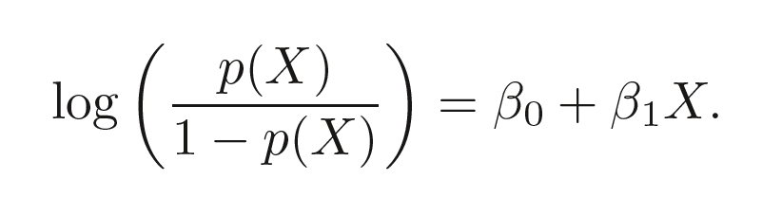
Notes:
Example of IL10 project (tSNE and heatmaps from a bioinformatics project)

Slide 23
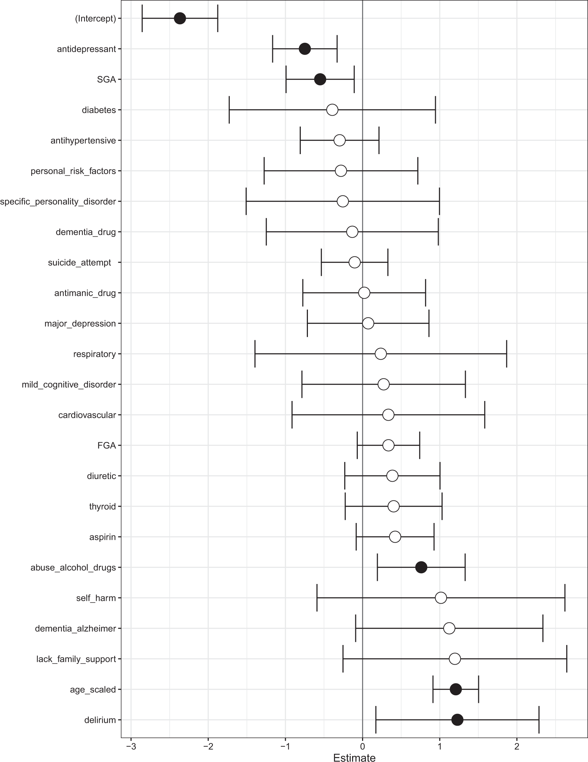
Notes:
Example of IL10 project (tSNE and heatmaps from a bioinformatics project)

Slide 24
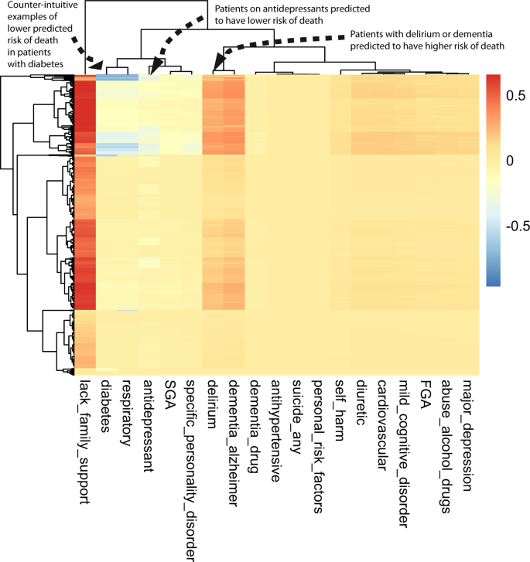
Notes:
Example of IL10 project (tSNE and heatmaps from a bioinformatics project)

Slide 25
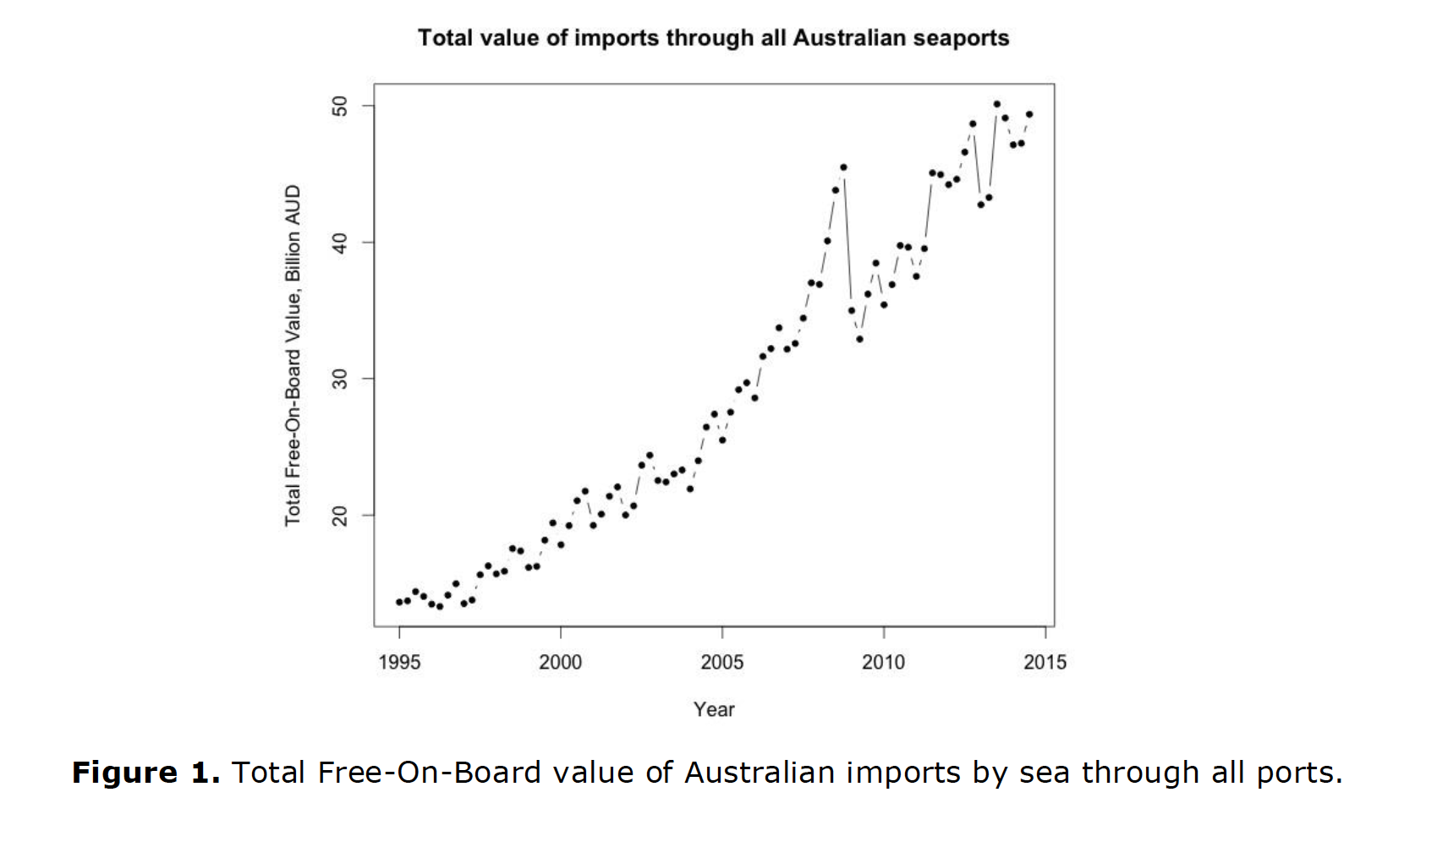
Notes:
Example of IL10 project (tSNE and heatmaps from a bioinformatics project)

Slide 26
Visualizing the data (for example, time-series data) can reveal what kinds of models would be appropriate. For example, if time series data has some seasonality, then a seasonal auto-regressive model (SARIMA) may be appropriate.
Visualization may also reveal if the underlying model/assumptions may have changed after a certain time. For example, in financial time-series data, there usually is a change after 2008 due to the global financial crisis.
This may suggest that a new model or more data is required.
Notes:
Example of IL10 project (tSNE and heatmaps from a bioinformatics project)

Slide 27
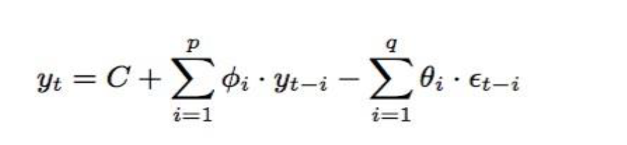
Notes:
Example of IL10 project (tSNE and heatmaps from a bioinformatics project)

Slide 28
Assumptions
Similar to linear regression/GLM (VAR model/ARIMA)
Look at correlations
Simpler models are better (moving averages better than anything fancy/ML)
Notes:
Example of IL10 project (tSNE and heatmaps from a bioinformatics project)

Slide 29
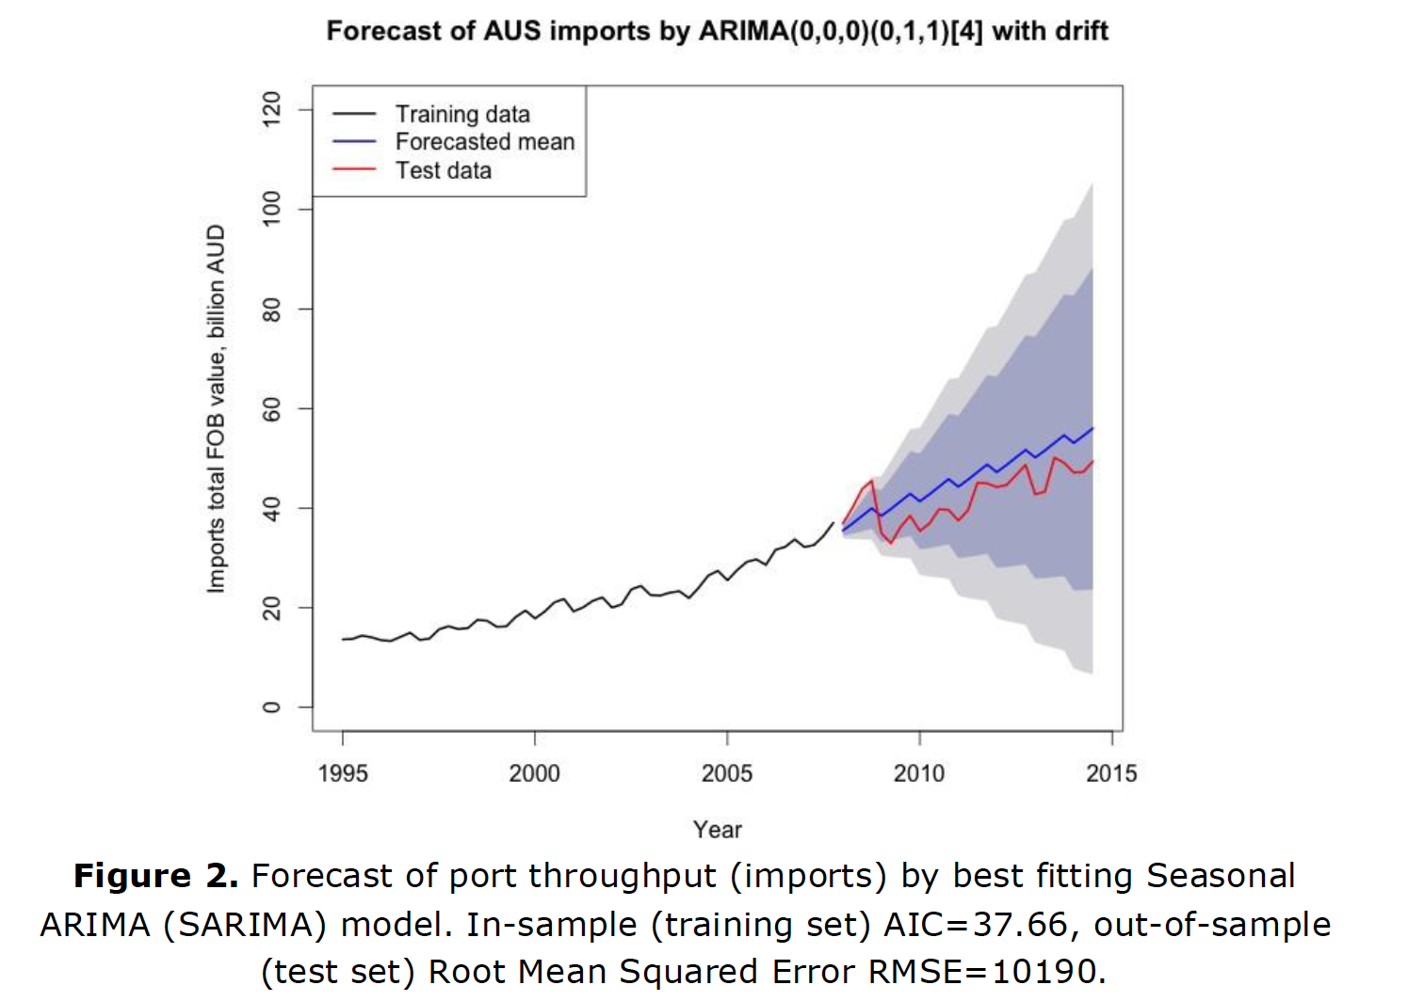
Notes:
Example of IL10 project (tSNE and heatmaps from a bioinformatics project)

Slide 30
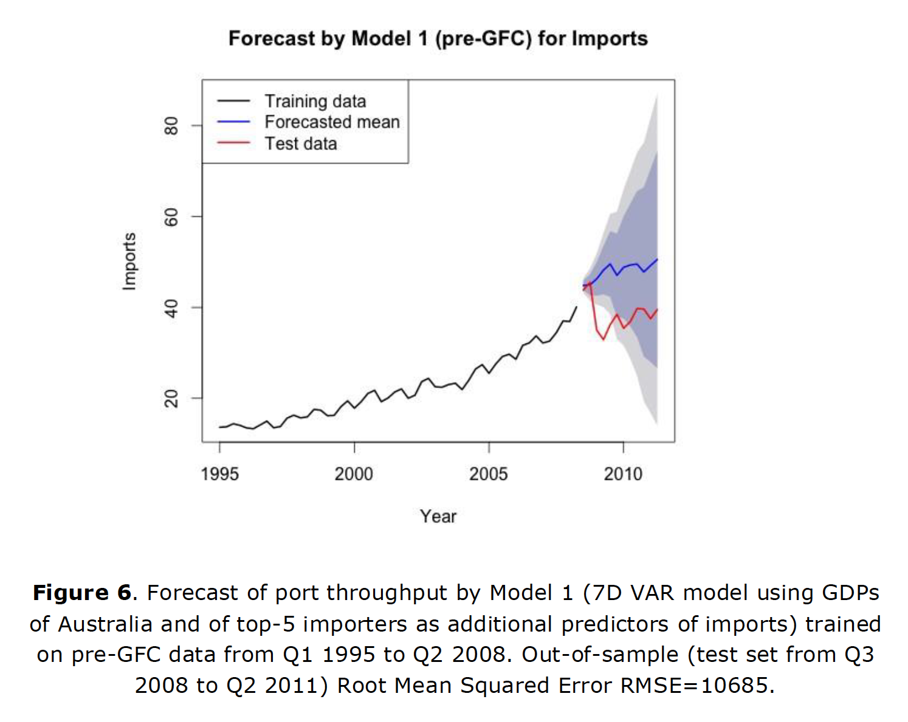
Notes:
Example of IL10 project (tSNE and heatmaps from a bioinformatics project)

Slide 31
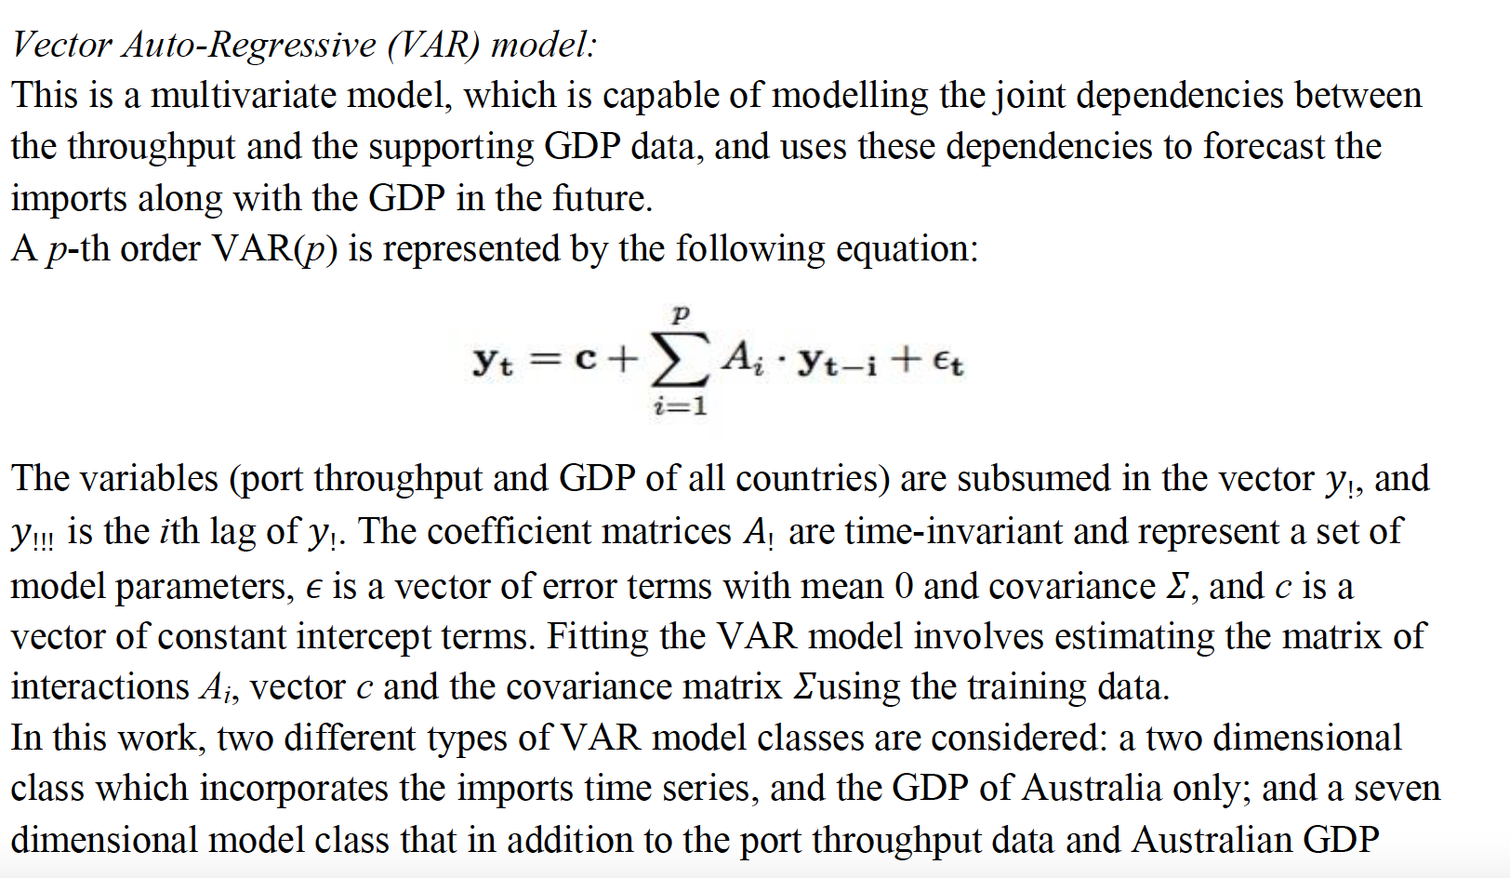
Notes:
Example of IL10 project (tSNE and heatmaps from a bioinformatics project)

Slide 32
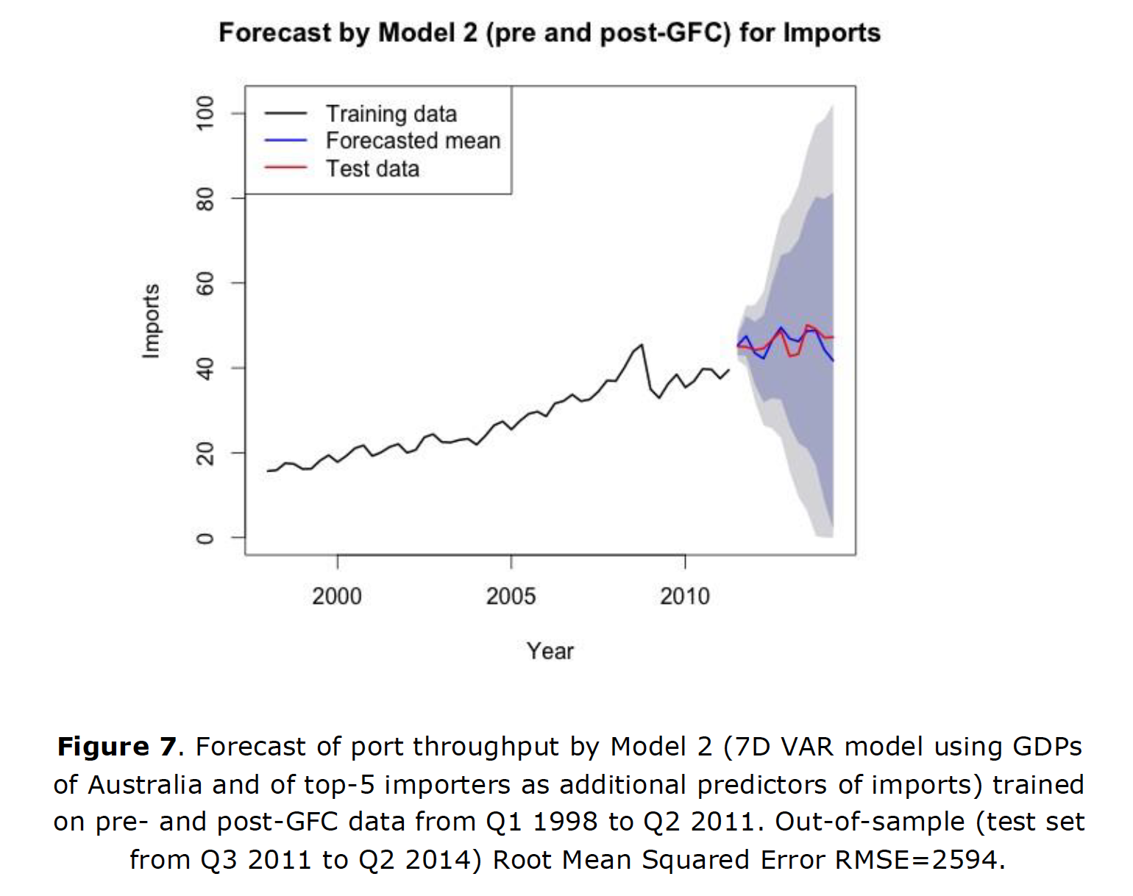
Notes:
Example of IL10 project (tSNE and heatmaps from a bioinformatics project)

Slide 33
Shiny apps for rapid prototyping and communication
Notes:
Example of IL10 project (tSNE and heatmaps from a bioinformatics project)

Slide 34
material
Material, code, exercises, activities
https://github.com/neelsoumya/visualization_lecture
Derivations and technical details
https://github.com/neelsoumya/visualization_lecture/blob/main/mathematics_data_science.pdf

